Slide 1
Case Study – BioPharma INC
Prerna Malakar
Rupesh Garg
Rishi Ratan Pathak
Yomesh Yadav
Vadthya Sanjay Kumar
Utsav Kumar Patel

Slide 2
Description
In 2005, Biopharma Inc. had experienced a steep decline in profits and very high costs at its plants in Germany and Japan. The president of the company for worldwide operation knew the demand for the company products was stable across the globe, as result the surplus capacity in his global network looked like luxury that he can’t longer afford Brunsson, Nils (1982). Any improvement in financial performance was dependent on having the most efficient network in place because revenues were unlikely to grow. Biopharma is global manufacturers of bulk chemicals used in pharmaceutical industry. The company holds patent on two chemicals that are called Highcal and Relax internally. The chemicals are used internally and are also sold to others drug manufacturers.
About the various plants located across the globe -:
• The Japanese plant is a technology leader within Biopharma network in terms of its ability to handle regulatory and environmental issues. Some developments in the Japanese plant had been transferred to other plants in the network.
• German plant is a leader in terms of its production ability. Highest yield in within the global network.
• Brazilian, Indian and Mexican plants are technology outdated and are in need of an update.
• Market is stable, only region Asia w/o Japan expects to grow in sales by 10% annually during the next 5years.
Products and Services they offer
Its holds patents on 2 chemical compound
Highcal
Relax.

Slide 3
Major Supply Chain Components
Planning
Manufacturing
Delivery
Sourcing

Slide 4
Major Supply Chain Performance Drivers
Bio pharma has setup their facilities at total 6 location (brazil, Germany, India, Japan, Mexico and USA ) where they both produce and procure. The first physical facility in the supply chain network is the physical location where the pay product is stored, this location can be of two types, first (production site) and second storage location.
.
Facilities
Bio pharma Inc. decided to place the inventory and facilities at same
position. Inventory of a supply chain includes all types of raw materials and finished goods. Changing inventory policies is considered very sensitive, as it can also dramatically change the efficiency and accountability of the supply chain.
Inventory
For transportation they used special containers for transportation via
sea and road. Transport works for different modes and routes with their own performance characteristics: full truck, courier, part load. Choosing transportation options has a major impact on accountability and efficiency for the supply chain.
Transportation
The power of information grows stronger every year as the technology for collecting and sharing info becomes more accessible, affordable, and easier to use. For the inventory they predicted that their demand will be stable in all parts of the world except Asia without Japan because they forecasted the sales to grow by 10% annual for each of the next 5 years.
Information

Slide 5
Problem and objective
From the information provided, we can learn that the BioPharma Inc. has experienced more than one problem and the serious ones are as follows:
Steep decline in profits
Improper Capacity distribution among the plants
Problems
Very high costs at Germany and Japan plants
Company could no longer afford to have surplus capacity
Problems faced in financial performance of Biopharma Inc.

Slide 6
Plant | Capacity (in million Kgs) | Highcal |  | Relax
 |  | Sales (in million Kgs) | Production (in million Kgs) | Sales (in million Kgs) | Production (in million Kgs)
Brazil | 18 | 7 | 11 | 7 | 7
Germany | 45 | 15 | 15 | 12 | 0
India | 18 | 5 | 10 | 3 | 8
Japan | 10 | 7 | 2 | 8 | 0
Mexico | 30 | 3 | 12 | 3 | 18
USA | 22 | 18 | 5 | 17 | 17
Plant | Total Capacity | Total Sales | Max Sales Possible | Total Production | Production-Capacity | Sales-Capacity
Brazil | 18 | 14 | 15 | 18 | 0 | -4
Germany | 45 | 27 | 28 | 15 | -30 | -18
India | 18 | 8 | 9 | 18 | 0 | -10
Japan | 10 | 15 | 16 | 2 | -8 | 5
Mexico | 30 | 6 | 7 | 30 | 0 | -24
USA | 22 | 35 | 36 | 22 | 0 | 13
Total | 143 | 105 | 111 | 105

Slide 7
Plant | Plant Fixed Cost (in million $) | Total capacity (in million kg) | Highcal Fixed Cost (in million $) | Relax Fixed Cost (in million $) | Highcal | Relax
 |  |  |  |  | Production Cost/kg | Production Cost/kg
Brazil | 20 | 18 | 5 | 5 | 8.7 | 11.2
Germany | 45 | 45 | 13 | 14 | 10.9 | 13.5
India | 18 | 18 | 4 | 4 | 8.1 | 10.5
Japan | 17 | 10 | 6 | 6 | 11.4 | 14.1
Mexico | 30 | 30 | 6 | 6 | 9.6 | 11.1
USA | 21 | 22 | 5 | 5 | 8.6 | 11
Plant | Fixed Cost ($/kg)
Brazil | 1.110
Germany | 1.000
India | 1.000
Japan | 1.700
Mexico | 1.000
USA | 0.955

Slide 8
Transportation Cost Data -
Plant/Market | Latin America ($/kg) | Europe ($/kg) | Asia w/o Japan ($/kg) | Japan ($/kg) | Mexico ($/kg) | USA ($/kg)
Brazil | 0.2 | 0.45 | 0.5 | 0.5 | 0.4 | 0.45
Germany | 0.45 | 0.2 | 0.35 | 0.4 | 0.3 | 0.3
India | 0.5 | 0.35 | 0.2 | 0.3 | 0.5 | 0.45
Japan | 0.5 | 0.4 | 0.3 | 0.1 | 0.45 | 0.45
Mexico | 0.4 | 0.3 | 0.5 | 0.45 | 0.2 | 0.25
USA | 0.45 | 0.3 | 0.45 | 0.45 | 0.25 | 0.2
Import Duty data -
Market | Latin America | Europe | Asia w/o Japan | Japan | Mexico | U.S
Import Tariffs | 30% | 3% | 27% | 6% | 35% | 4%

Slide 9
How the firm has addressed those supply chain challenges?
The company did two things to overcome this challenges -:
Closing down the Japan plant
In Germany plant restricting down the production to only one chemical
Impact of firm decision on cost –
By closing of japan plant -
a. Eliminated all variable cost (22.8 million $)
b. Saved 80% of annual fixed costs (23.2 million$) rest 20% is due to plant shutdown.
By restricting to only Highcal in Germany plant -
company saved 80% of fixed cost associated with relax (11.2 million $).

Slide 10
Objective
Bearing in mind the problem as stated above in our objective for this work is naturally twofold:
To minimize the total cost in which fixed costs, production costs, transportation costs of transporting goods from plants to customers and import duties are included.
To maximize the synchronization (sync) between sales, production and capacity of Bio Pharma while changing the capacity to amount of sales + buffer (=2 million kgs) and changing some required costs also.

Slide 11
How would you have addressed those supply chain challenges?
Ans: If :-
n = no. of potential factory locations
m= no. of market or demand points
Dj= annual demand from market j
Ki= potential annual capacity of factory i
Fi= annualized fixed cost of keeping factory i open
Cij= cost of shipping one unit from factory i to market j
Xij=quantity shipped from factory i to market j}
Uj= import duty in the jth market
yi= 1 { if factory i is open else 0}
Z= 0 { if i=j else 1}

Slide 12
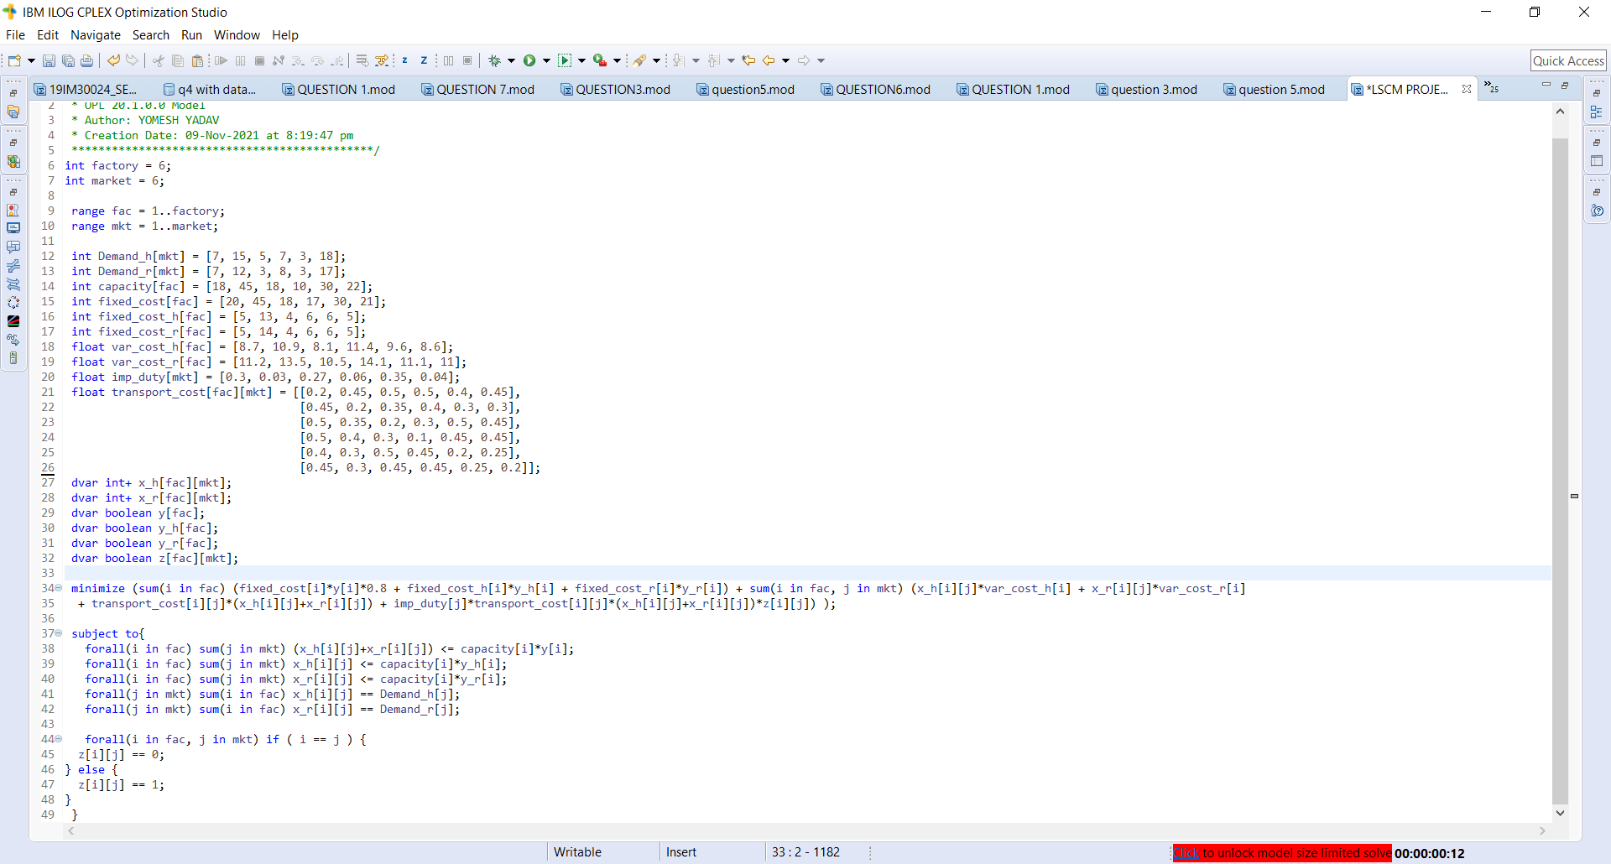

Slide 13
Note - All the costs are in Million Dollars and all the production values are in Million Kgs
y | 1 | 1 | 1 | 0 | 1 | 1
y_highcal | 1 | 1 | 0 | 0 | 0 | 1
y_relax | 1 | 0 | 1 | 0 | 1 | 0
Production data for Highcal -
Plant/Market | Latin America | Europe | Asia w/o Japan | Japan | Mexico | USA
Brazil | 7 | 0 | 2 | 7 | 0 | 0
Germany | 0 | 14 | 3 | 0 | 0 | 0
India | 0 | 0 | 0 | 0 | 0 | 0
Japan | 0 | 0 | 0 | 0 | 0 | 0
Mexico | 0 | 0 | 0 | 0 | 0 | 0
USA | 0 | 1 | 0 | 0 | 3 | 18

Slide 14
Production data for Relax -
Plant/Market | Latin America | Europe | Asia w/o Japan | Japan | Mexico | USA
Brazil | 2 | 0 | 0 | 0 | 0 | 0
Germany | 0 | 0 | 0 | 0 | 0 | 0
India | 0 | 7 | 3 | 8 | 0 | 0
Japan | 0 | 0 | 0 | 0 | 0 | 0
Mexico | 5 | 5 | 0 | 0 | 3 | 17
USA | 0 | 0 | 0 | 0 | 0 | 0
Plant | Fixed Cost
Brazil | 20
Germany | 45
India | 18
Japan | 3.4
Mexico | 30
USA | 21
Total Fixed Cost | 137.4

Slide 15
Production cost calculation for Highcal -
Plant | Total Production | Fixed cost | Production Cost
Brazil | 16 | 5 | 139.2
Germany | 17 | 13 | 185.3
India | 0 | 0 | 0
Japan | 0 | 0 | 0
Mexico | 0 | 0 | 0
USA | 22 | 5 | 189.2
Total | 55 | 23 | 513.7
Production cost calculation for Relax -
Plant | Total Production | Fixed cost | Production Cost
Brazil | 2 | 5 | 22.4
Germany | 0 | 0 | 0
India | 18 | 4 | 189
Japan | 0 | 0 | 0
Mexico | 30 | 6 | 333
USA | 0 | 0 | 0
Total | 50 | 15 | 544.4

Slide 16
Transportation Cost calculation for Highcal -
Plant/Market | Latin America | Europe | Asia w/o Japan | Japan | Mexico | USA | Total Cost/plant
Brazil | 1.4 | 0 | 1 | 3.5 | 0 | 0 | 5.9
Germany | 0 | 2.8 | 1.05 | 0 | 0 | 0 | 3.85
India | 0 | 0 | 0 | 0 | 0 | 0 | 0
Japan | 0 | 0 | 0 | 0 | 0 | 0 | 0
Mexico | 0 | 0 | 0 | 0 | 0 | 0 | 0
USA | 0 | 0.3 | 0 | 0 | 0.75 | 3.6 | 4.65
Total Transportation Cost | 14.4
Transportation Cost calculation for Relax -
Plant/Market | Latin America | Europe | Asia w/o Japan | Japan | Mexico | USA | Total Cost/plant
Brazil | 0.4 | 0 | 0 | 0 | 0 | 0 | 0.4
Germany | 0 | 0 | 0 | 0 | 0 | 0 | 0
India | 0 | 2.45 | 0.6 | 2.4 | 0 | 0 | 5.45
Japan | 0 | 0 | 0 | 0 | 0 | 0 | 0
Mexico | 2 | 1.5 | 0 | 0 | 0.6 | 4.25 | 8.35
USA | 0 | 0 | 0 | 0 | 0 | 0 | 0
Total Transportation Cost | 14.2

Slide 17
Import Duty calculation for Highcal -
Plant/Market | Latin America | Europe | Asia w/o Japan | Japan | Mexico | USA | Total Duty/plant
Brazil | 0 | 0 | 0.108 | 0.084 | 0 | 0 | 0.192
Germany | 0 | 0 | 0.3645 | 0 | 0 | 0 | 0.3645
India | 0 | 0 | 0 | 0 | 0 | 0 | 0
Japan | 0 | 0 | 0 | 0 | 0 | 0 | 0
Mexico | 0 | 0 | 0 | 0 | 0 | 0 | 0
USA | 0 | 0.0135 | 0 | 0 | 0.4725 | 0 | 0.486
Total Import Duties | 1.0425
Import Duty calculation for Relax -
Plant/Market | Latin America | Europe | Asia w/o Japan | Japan | Mexico | USA | Total Duty/plant
Brazil | 0 | 0 | 0 | 0 | 0 | 0 | 0
Germany | 0 | 0 | 0 | 0 | 0 | 0 | 0
India | 0 | 0.0945 | 0 | 0.144 | 0 | 0 | 0.2385
Japan | 0 | 0 | 0 | 0 | 0 | 0 | 0
Mexico | 0.675 | 0.0675 | 0 | 0 | 0 | 0.306 | 1.0485
USA | 0 | 0 | 0 | 0 | 0 | 0 | 0
Total Import Duties | 1.2870

Slide 18
Question 1
How should BioPharma have used its production network in 2009? Should any of the plants have been idled? What is the annual cost of your proposal, including import duties?
Ans: BioPharma should have used its production network in 2009 as shown in the production data tables.
As shown in the tables, one result is clear that the Japan plant should be completely idled, India and Mexico produced none of the Highcal product and that side of their plants has been idled and Germany and USA produced none of the Relax product and that side of their plants has been idled.
Total Fixed Cost = $175.4 million
Total production Cost = $1058.1 million
Total Transportation Cost = $28.6 million
Total Import Duties = $2.3295 million
Overall Total Cost = $1264.168 million

Slide 19
Question 2
Is there any plant for which it may be worth adding a million kgs of additional capacities at a fixed cost of $3 million/year?
Ans: It doesn’t appear this improves the solution shown in question 1. The plants that are at capacity, i.e., capacity = total production, in part 1 are Brazil, India, Mexico, and the U.S.; adding a million kilograms of capacity to those plants does not result in a lower overall cost for the entire supply chain.

Slide 20
Question 3
How are your recommendations affected by the reduction of duties?
Ans: A reduction in duties to 0% across the board results in the following costs –
Total Fixed Cost = $175.4 million
Total production Cost = $1058.1 million
Total Transportation Cost = $28.6 million
Overall Total Cost = $1262.1 million (reduction of $2.068 million)
We observed a minute change in the Highcal production data but the Relax production data was exactly the same. The Highcal production data without import duties is shown below -
Plant/Market | Latin America | Europe | Asia w/o Japan | Japan | Mexico | USA
Brazil | 7 | 0 | 3 | 6 | 0 | 0
Germany | 0 | 15 | 2 | 0 | 0 | 0
India | 0 | 0 | 0 | 0 | 0 | 0
Japan | 0 | 0 | 0 | 0 | 0 | 0
Mexico | 0 | 0 | 0 | 0 | 0 | 0
USA | 0 | 0 | 0 | 1 | 3 | 18

Slide 21
Question 4
The analysis has assumed that each plant has a100 percent yield (percent output of acceptable quality). How would you modify your analysis to account for yield differences across plants?
Ans: We will modify our analysis to account for yield differences across plants by adding a new constraint which is given as:
Xij = Si × Wij for all i,j
where Si = percentage acceptable or yield of factory i
Wij = actual quantity produced

Slide 22
Question 5
What other factors should be accounted for when making your recommendations?
Ans: Other factors to be accounted for when making recommendations are:
Disruptions like disasters, war, terrorism, labor disputes
Delays, inflexibility or poor yield of supply, insufficient supply
Systems failures and system integration issues
Inaccurate forecasting
Vertical integration and global sourcing Exchange rate movement, industry-wide capacity issues
Number and financial strength of customers
Rate of obsolescence, holding costs, uncertainty of demand
Cost and flexibility of capacity

Slide 23
Conclusion
The presentation has outlined a mathematical model used to minimize the total cost for bio pharma .
The savings done by using our mathematical model were as follows :
Reduction in fixed cost of $34.6 million
Reduction in production cost of $12.3 million
Transportation costs and import duties were nearly the same.
It was surprising that the decision taken by bio pharma in 2009 was exactly same to the solution provided by our mathematical model.
At last we came to the conclusion that the decision of closing the Japan plant and restricting the chemical to only highcal in Germany was the best alternative possible the reason being was mainly to avoid high running costs of the plants due to their relatively higher cost of raw materials and production (also the high fixed cost of japan)

Slide 24
Thank You!!!

